Slide 1
AN ANALYSIS OF CUSTOMER SENTIMENTS ACROSS ALL THAI RESTAURANTS in new york city
Olarn Pornpitaksuk
Springboard Capstone Project
February 1, 2017

Slide 2
Project Objective and Background
As a member of family that owns Thai restaurants in New York City, listening to customer feedback and understanding how they rate Thai food and service is valuable information for improving a business.
Situation
Consideration
Yelp has developed a wonderful community where customers can share their experiences about restaurants by sharing ratings and reviews.
This created a treasure trove of data that can be used to assess customer sentiment for restaurants across New York City.
Question
How can we access this data source?
How can we build a predictive model that is able to accurately predict whether a review is good (4 or 5 stars) or bad (1 2 or 3 stars) by analyzing the included words?
What insights can we extract from this model to improve our business?

Slide 3
Overview of Topics Covered
Data Scraping Methods
Exploratory Data Analysis
Data Pre-Processing
Model Selection and Parameter Estimation
Model Evaluation
Business Insights and Recommendation

Slide 4
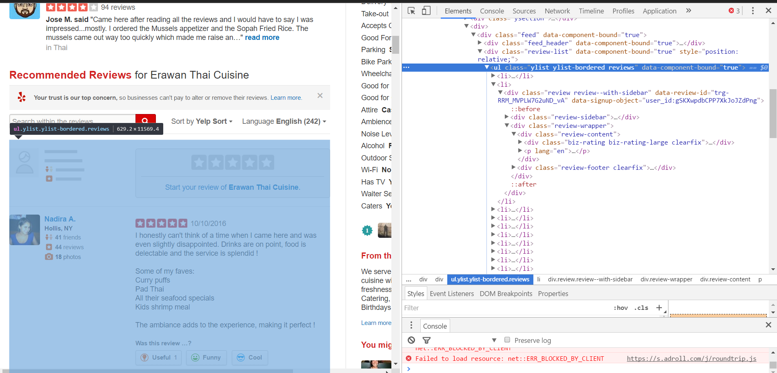
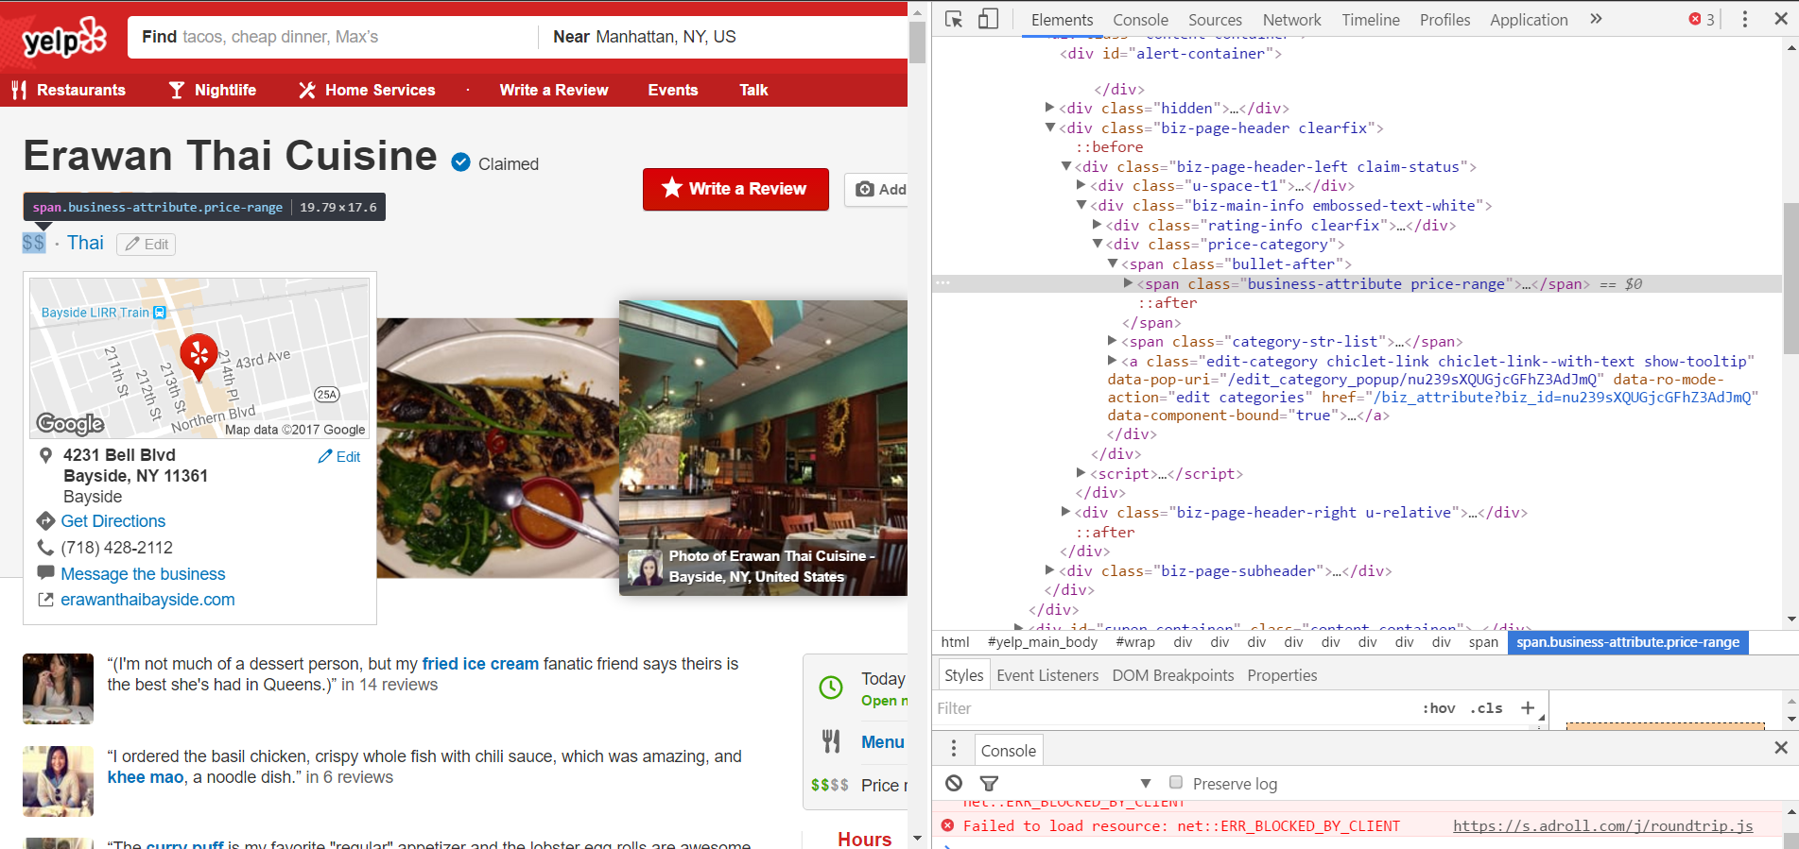
A web scraper was developed to collect the review and metadata for each restaurant.
Processing was divided into two stages to collect each type of data by using the Beautiful soup and lxml packages, in addition to the web browser tool.
Review Data
Metadata
Review data are restaurant rating and reviews written by members on the Yelp website
A web crawler was developed to iterate across each page of reviews, with each page containing several reviews
A total of 83,349 rating and reviews were collected from 541 Thai restaurants in New York City
Metadata are attributes self-reported by the restaurants (e.g. price, availability of waiter service, alcoholic beverages)
A webs crawler was developed to iterate across all Thai restaurants that appeared in a New York City Thai restaurant query
For each of the 541 Thai restaurants in New York City, 28 distinct attributes/features were collected.

Slide 5
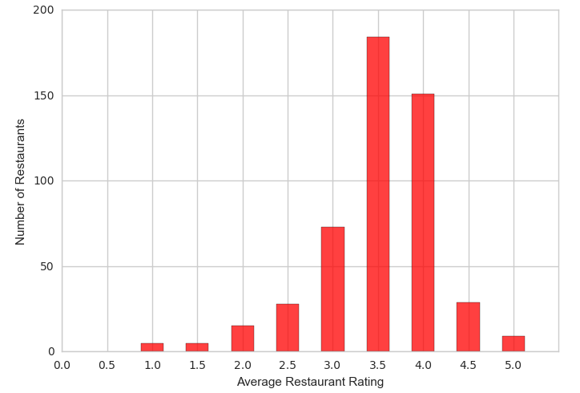
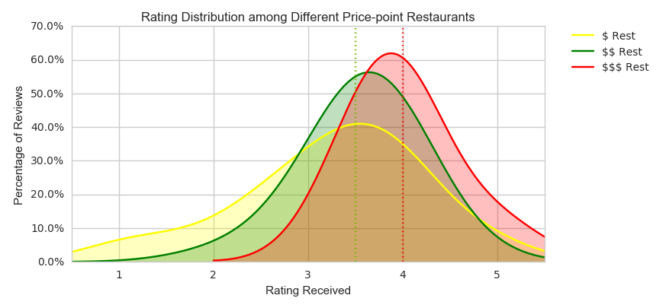
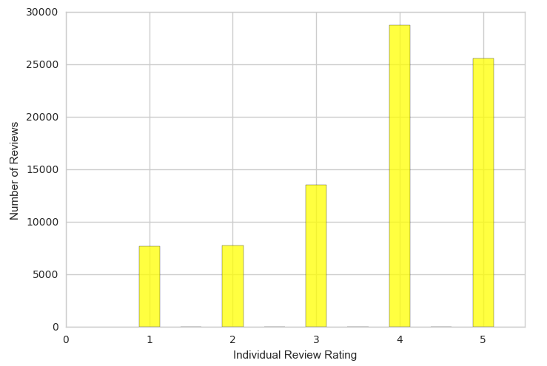
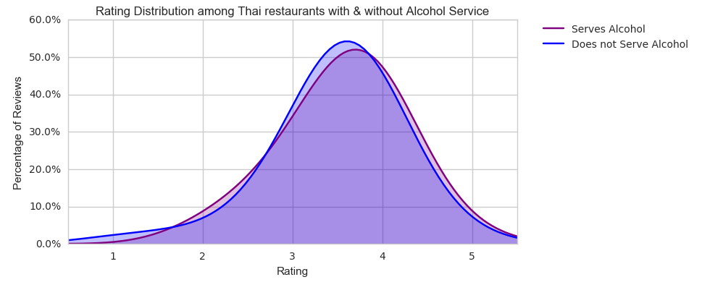
The review and metadata sets were explored with the guidance of key questions.
What is the distribution of average rating
across Thai restaurants in New York City?
Do restaurants that are more expensive
generally receive higher ratings?
What is distribution of individual ratings across
all reviews of Thai Restaurants in New York City?
Do Thai restaurants that serve alcohol
generally receive higher ratings?

Slide 6
Collected data was pre-processed to become suitable for text mining models.
The review data was cleaned and refined using several processes.
Tokenization
All reviews were broken up into its individual words
Words were set as lower-case and all punctuation was removed
Stop words were removed from the set
N-grams
A search grid function between n-gram values between 1 and 3 was applied, optimizing towards the best F1 score
N-gram set to 2 was selected because it significantly increased the vocabulary in our lexicon, and would improve performance related to positioning patterns in sentences
Minimum Document
Frequency
A search grid function between n-gram values between .00001 and 1 was applied, optimizing towards the best F1 score
Minimum document frequency was set to 0.001 because it was the most optimal value for model performance
Bag of Words
With these rules in mind, reviews were converted into a bag of words representation
The lexicon contained 71,510 unique features (including pair of words)
Chi-squared
Feature Reduction
Chi-squared feature reduction was applied to our lexicon to reduce the features to contain only the most highly correlated words
A alpha of p = 0.05 was chosen for our significance threshold
The reduced lexicon contained 24,915 features

Slide 7
Several models were selected for text classification, with performance measured with the F1 metric.
Naïve Bayes
Logistic Regression
Support Vector
Classification
Simplest and effective text classifying algorithms
Computationally inexpensive
Fast to train
Often times performs very close to more complicated and less efficient techniques
Effective ability assign weights to features for binary classification
Incredibly easy to implement
Computationally inexpensive
Knowledge representation would be fairly easy to interpret
Performs well in high-dimensional input space
Text classification can have over 10,000 features
However, SVC does not directly provide probability estimates
Models were optimized to the F1 metric because it contained the most balanced composition of true positives and true negatives, and both error types were considered equally harmful to the restaurant business care.
False Positives lead to a failure to recognize restaurant pain points.
False Negatives lead to wasting effort on improving the wrong parts of the restaurant.

Slide 8
Hyperparameter for each model was selected by applying a grid search and optimizing towards the highest F1 score.
Naïve Bayes
Logistic Regression
Support Vector
Classification
The search grid scanned values of hyperparameter alpha between 0001 through 10,000 by orders of magnitude
Alpha = 1.0 was discovered as the highest performing parameters against the F1 score.
The search grid scanned values of hyperparameter C between .01 through 100 by orders of magnitude.
C = .01 was discovered to be the highest performing parameter against the F1 score.
The search grid scanned values of hyperparameter C between .01 through 100 by orders of magnitude.
C = 100 was discovered to be the highest performing parameter against the F1 score.

Slide 9
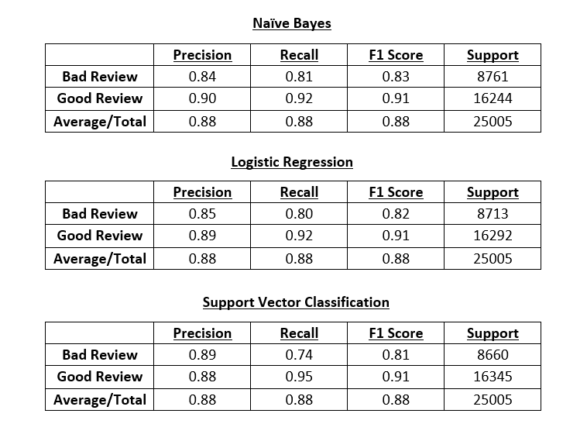
Model performance was evaluated by analyzing each model’s F1 Score, the Confusion Matrix, ROC Curve & the Precision Recall Curve.
Surprisingly, all three classifiers performed equally well on the F1 metric with a score of 0.88. This indicated that harmonic mean of precision and recall be equally maximized effectively as moderate performance on both would be favored over exceptional performance on any individual metric.

Slide 10
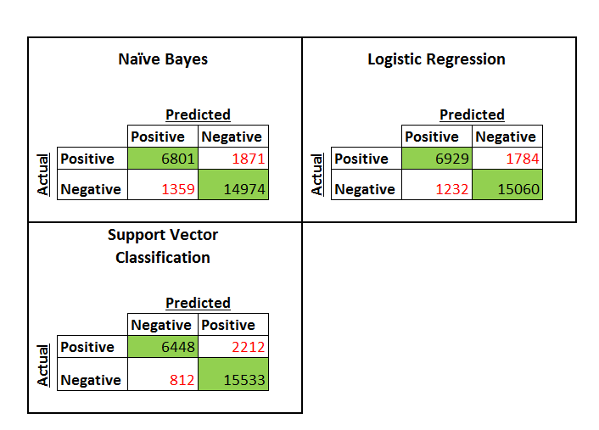
Model performance was evaluated by analyzing each model’s F1 Score, the Confusion Matrix, ROC Curve & the Precision Recall Curve.
The confusion matrices allowed us to identify the Logistic Regression classifier has the strongest because it possessed the lowest amount of prediction errors and the most balanced ratio between false negatives and false positives.

Slide 11
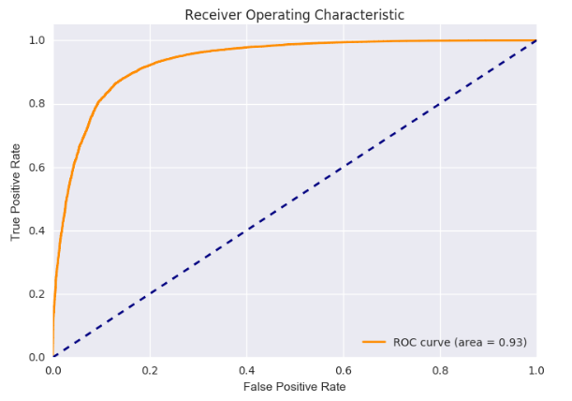
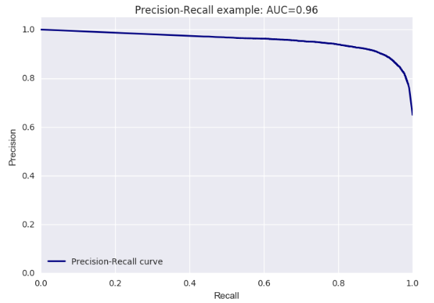
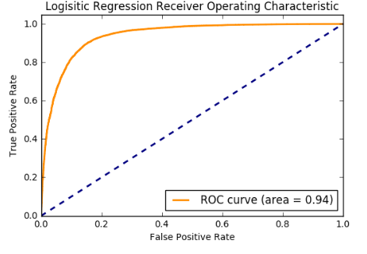
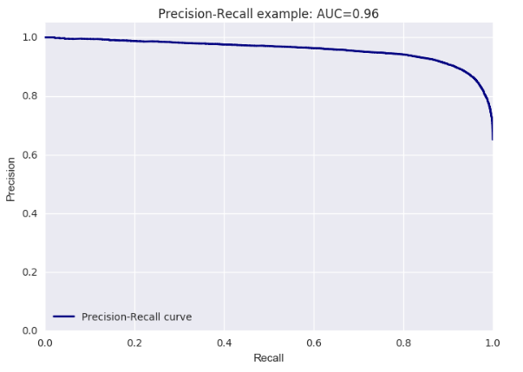
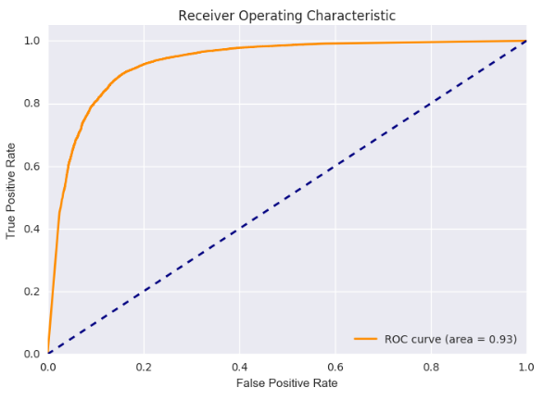
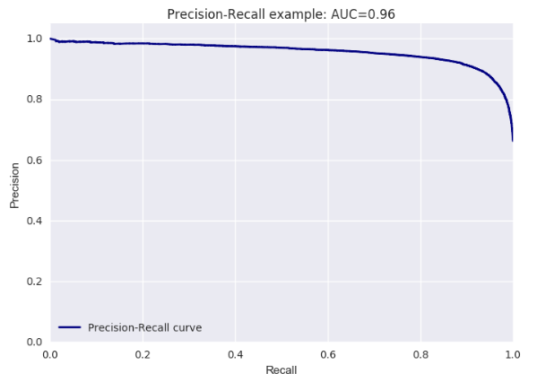
Model performance was evaluated by analyzing each model’s F1 Score, the Confusion Matrix, ROC Curve & the Precision Recall Curve.
Naïve Bayes
Logistic Regression
Support Vector Classification
All three classifiers achieved a Precision-Recall AUC score of 0.96, with marginal differences in the ROC AUC score. The Logistic Regression achieved the highest ROC AUC score at 0.94, while the Naïve Bayes and SVC achieved 0.01 less at 0.93.

Slide 12
Logistic Regression was the highest performing text classifier.
Because all three classifiers were incredibly similar, the only differentiator of performance was the confusion matrix and the ROC curve.
The Logistic Regression was the highest performing classifier when evaluated on these remaining metrics.
According to the confusion matrix, Logistic Regression predicted less errors than both Naïve Bayes and SVC.
According to the ROC Curve, Logistic Regression also had the highest ROC AUC value at 0.94 when compared to 0.93 of the other classifiers.
Therefore, the text classifier chosen to evaluate our Thai restaurant was the Logistic Regression model.
Model Evaluation

Slide 13
Business insights were extracted from the Logistic Regression model using two methods.
Observe the appearance of highly influential words and their frequency
Compare the local probability of words with their universal probability
Method #1
Method #2
MOST INFLUENTIAL WORDS FOR GOOD REVIEWS |  |  | MOST INFLUENTIAL WORDS FOR BAD REVIEWS
Word/Feature | Prob Good Review (Universal) | Frequency of Reviews | Word/Feature | Prob Good Review (Universal) | Frequency of Reviews
delicious | 83% | 54 | bit high | 36% | 14
happy | 82% | 10 | bumping | 37% | 1
disappoint | 81% | 12 | ridiculous | 37% | 3
felt bad | 80% | 11 | disappointment | 37% | 4
fantastic | 79% | 11 | food poisoning | 37% | 2
love | 77% | 39 | tasted old | 37% | 1
really good | 77% | 14 | underwhelming | 37% | 1
also yummy | 74% | 15 | hype | 37% | 1
often | 74% | 12 | miserable | 37% | 1
yum | 72% | 13 | increased | 38% | 1
good food | 72% | 12 | improve | 38% | 1
Best | 72% | 48 | mushy | 38% | 2
dipping sauces | 72% | 15 | refused | 38% | 1
whole thing | 71% | 16 | okay | 38% | 12
reasonable | 71% | 17 | extremely rude | 39% | 10
romantic | 71% | 12 | better thai | 41% | 8
great pad | 70% | 11 | basic | 43% | 18
Word/Feature | Prob Good Review (Universal) | Prob Good Review (Local) | Odds Ratio | Frequency of Reviews
coconut | 58% | 90% | 6.5172413 | 12
large | 62% | 88% | 4.4946236 | 8
cocktails | 58% | 83% | 3.5354969 | 6
wine | 65% | 86% | 3.3076923 | 7
specials | 54% | 79% | 3.2045855 | 15
sticky | 56% | 80% | 3.1428571 | 6
excellent | 81% | 92% | 2.6975308 | 16
pork | 61% | 80% | 2.5573770 | 5
presented | 54% | 75% | 2.5555555 | 4
red curry | 66% | 83% | 2.5151515 | 11
mango | 66% | 83% | 2.5151515 | 9
tofu | 62% | 80% | 2.4516129 | 7
pla | 62% | 80% | 2.4516129 | 10
curry dishes | 57% | 75% | 2.2631578 | 4
fried ice | 59% | 76% | 2.2005649 | 19
tom yum | 58% | 75% | 2.1724137 | 4

Slide 14
Applying Model Insights to Business Decisions
Recommendations
1
Understand the points of differentiation for the restaurant as voiced by customers
2
Identify strengths and weaknesses both internally within the restaurant’s product offerings, and externally against other competitors in New York City
3
Become aware of consistency issues with serve and in the kitchen
4
Keep an eye out for disgruntled employees
Source: Insight Strategy Advisors

Slide 15
Thank you.

